Slide 1
PHI-BLAST
(Pattern Hit Initiated BLAST)
FARUK ÜSTÜNEL
0405140026

Slide 2
What Is phI-blast?
• PHI-BLAST is an algorithm that combines regular expression pattern with local alignments surrounding the match in protein or DNA sequences of interest.

Slide 3
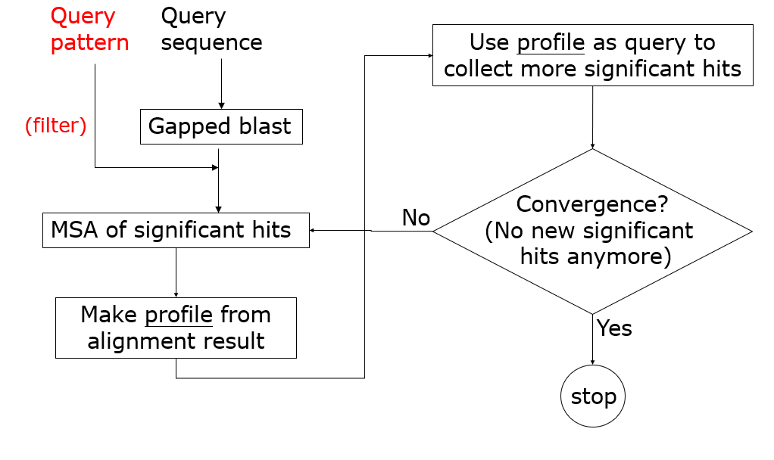
STEPS IN PHI-BLAST
MSA:
Multiple Sequence Alignment

Slide 4
How IT WORKS?
Given a sequence S and regular expression pattern P occurring in S,
PHI-BLAST searches for occurrence of P and also sequences homologous in the vicinity of P

Slide 5
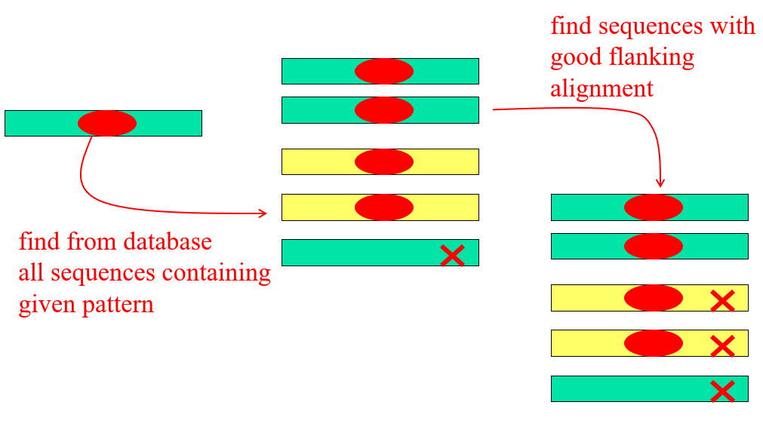
How IT WORKS?

Slide 6
ADVANTAGES
PHI-BLAST is integrated with Position-Specific Iterated BLAST (PSI-BLAST), so that the results of a PHI-BLAST query can be used to initiate one or more rounds of PSI-BLAST searching.
Databases can be searched very efficiently.

Slide 7
sYNTAx
The syntax for regular expression patterns follows the rules of PROSITE
PROSITE is a database which is consist of documentation entries describing protein domains, families and functional sites

Slide 8
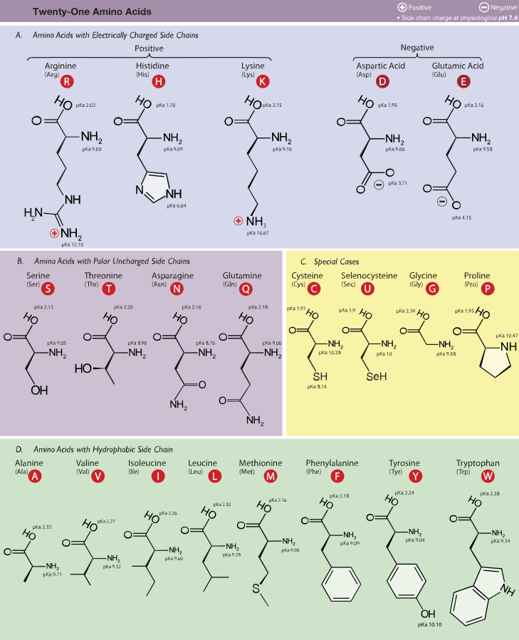
Pattern syntax used In the PROSITE database :
• The standart IUPAC one letter codes for the amino acid are used

Slide 9
• ‘x’ : any amino acid
• ‘[]’ : residues allowed at the position
• ‘{}’ : residues forbidden at the position
• ‘()’ : repetition of a pattern element like X(n) or X(n, m)
Examples:
X(3) : X-X-X
X(2,4) : X-X, X-X-X, X-X-X-X
You can only use a range with X not amino acids code!
A(2,4) is not valid!
• ‘-’ : separates each pattern element
• ‘<’ : indicated a N-terminal restriction of the pattern
• ‘>’ : indicated a C-terminal restriction of the pattern
• ‘.’ : the period ends the pattern.

Slide 10
Examples
[AC]-x-V-x(4)-{ED}
This pattern is translated as :
[Ala or Cys]-any-Val-any-any-any-any-{any but Glu or Asp}

Slide 11
Examples
< A-x-[ST](2)-x(0,1)-V
This pattern, which must be in the N-terminal of the sequence (`<'), is translated as:
Ala-any-[Ser or Thr]-[Ser or Thr]-(any or none)-Val

Slide 12
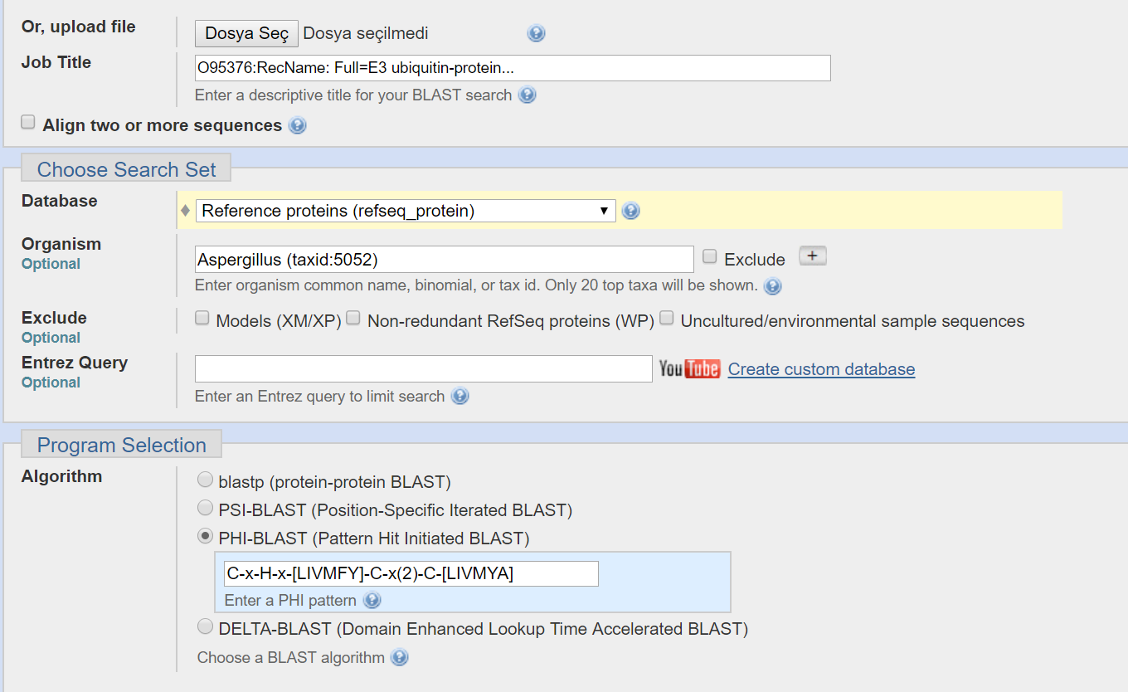
Example search
E3 Ubiquitin Ligase ARIH2 (Human)
Database: Refseq
Organism: Aspergillus
Pattern: C-x-H-x-[LIVMFY]-C-x(2)-C-[LIVMYA] (Zing Finger Motif)

Slide 13
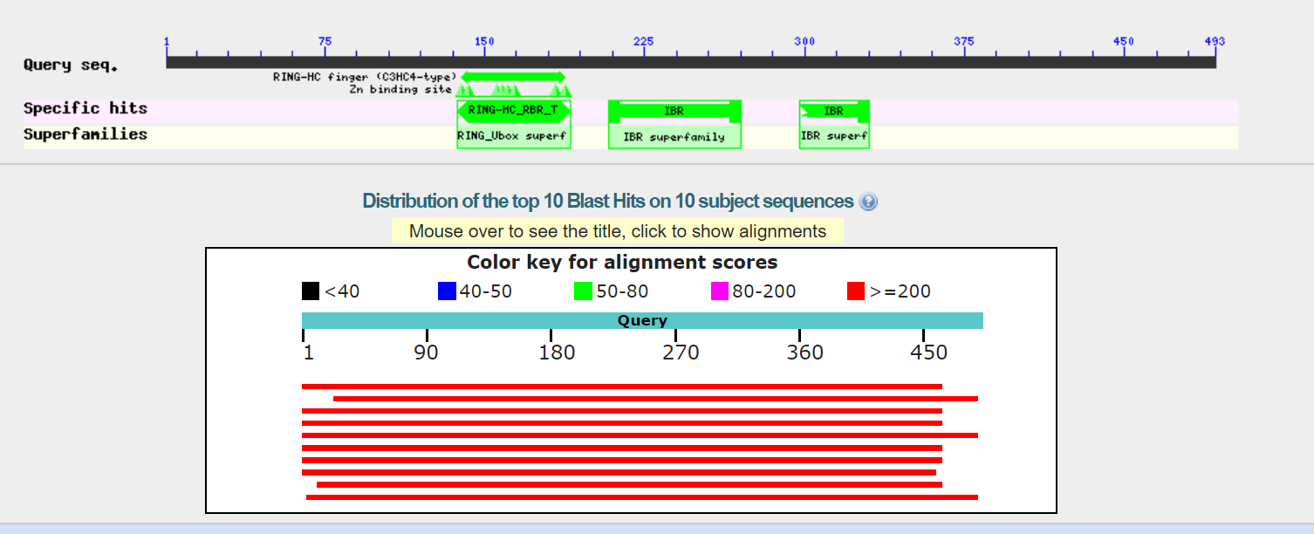
Example Search result

Slide 14
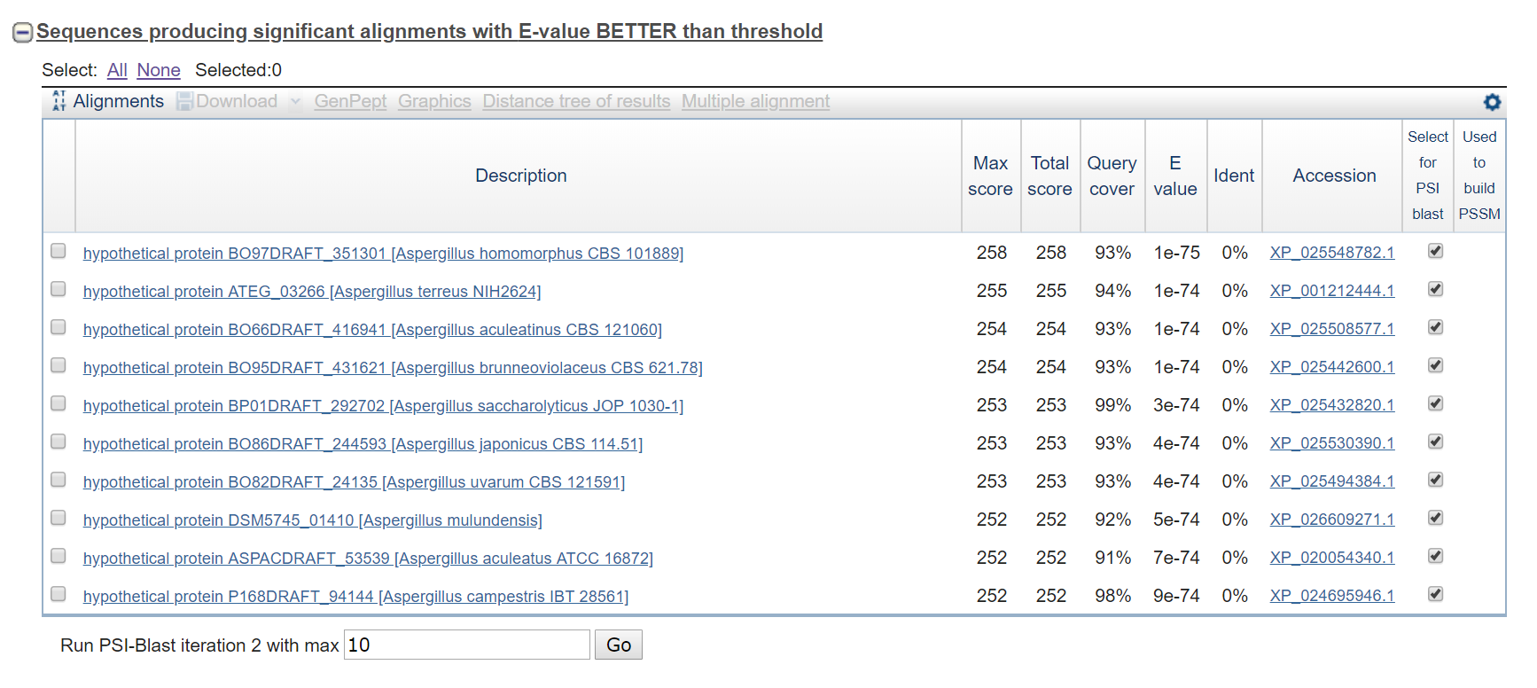
Example Search result

Slide 15
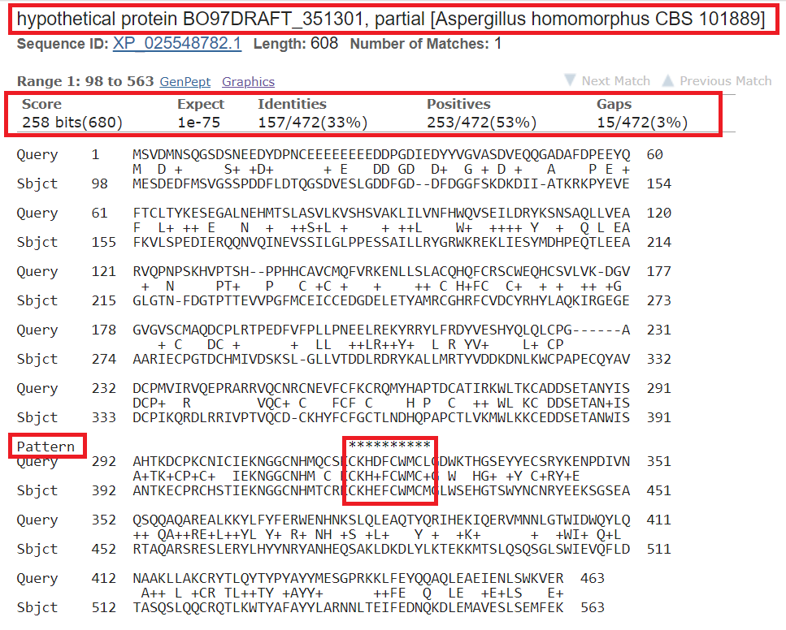
Example Search result

